Slide 1
Kaizen Sharing & New SOS Report
1 | Material feed to line model change for Mentor Media kitting materials | Selin
2 | Accuracy of customers' orders' delivery ack-date improvement | Kitty
3 | Excess Depletion Process | Iris
4 | Shortage material receiving process improvement | Bella
5 | New SOS report | Cindi
Aug.16th .2017

Slide 2
Kaizen Detail
Material feed to line model change for Mentor Media kitting materials
Selin Zhu

Slide 3

What is the Change?
-Process
-System
-Operation

Slide 4
Process change for the warehouse new tool
WH
WH put BKPL and material data into system
Production select PL to prepare material
Order drop
Order drop
Production print PL
WH receive PL
Production receive material
Production receive material
WH prepare material
WH prepare material

Slide 5
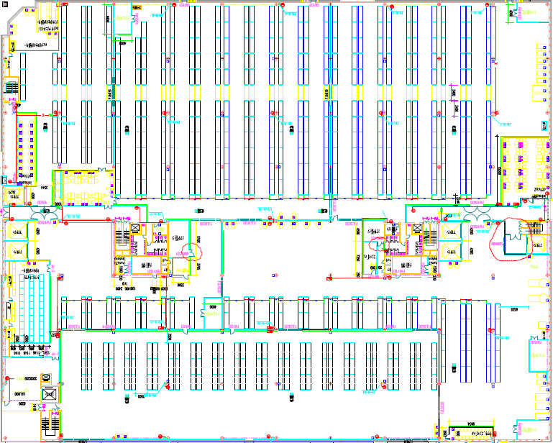
EMCN Shanghai
Team 1：Material feed to line model change for Mentor Media kitting materials
1st Floor August 07-11, 2017
Role | Name | Function
Team Lead | Zhi-Gang Yu | EMCN Warehouse
Co - Lead | Yan-Lin Fei | EMCN Mentor Media
Team Member | Chun-Hua Li | EMCN Warehouse
 | Selin Zhu | EMCN Buyer
 | Xiao-Li Qin | EMCN Planner
 | Chang-Peng Wu | EMCN Engineer
Facilitator | Min-Min Zhang | EMCN Warehouse Supervisor
Facilitator | Wah Say Wong | HPE KPO
Sponsor | Hai-Chuan Zhao | EMCN Engineering Manager
Specific Area For Metor Media

Slide 6
Question
905 format change
Date | P/N | Qty | Po | 送货商 | 905 Reason | CONTROL ID | Update PO - buyer | PO Reason - buyer
8/14/2017 | 775569-001 | 40 | BFE4004820 | Schenker | PO数量不足 | 7XC
8/14/2017 | 852914-002 | 28 | BFE4004766 | Schenker | PO不对 | 7XA
8/14/2017 | 863596-001 | 64 | BFE4004773 | Schenker | PO不对 | 7XA
8/15/2017 | 778718-001 | 192 | BFE4004617 | Schenker | PO不对 | 7XC
8/14/2017 | 775569-001 | 100 | BFE4004820 | Schenker | PO数量不足 | 7XC
8/14/2017 | 778718-001 | 24 | BFE4004617 | Schenker | PO不对 | 7XC
8/14/2017 | 831038-001 | 160 | BFYE027646 | kwe | PO未released | 7HE

Slide 7
Kaizen Detail
Accuracy of customers' orders' delivery ack-date improvement
Kitty Liu & Crystal Huang

Slide 8
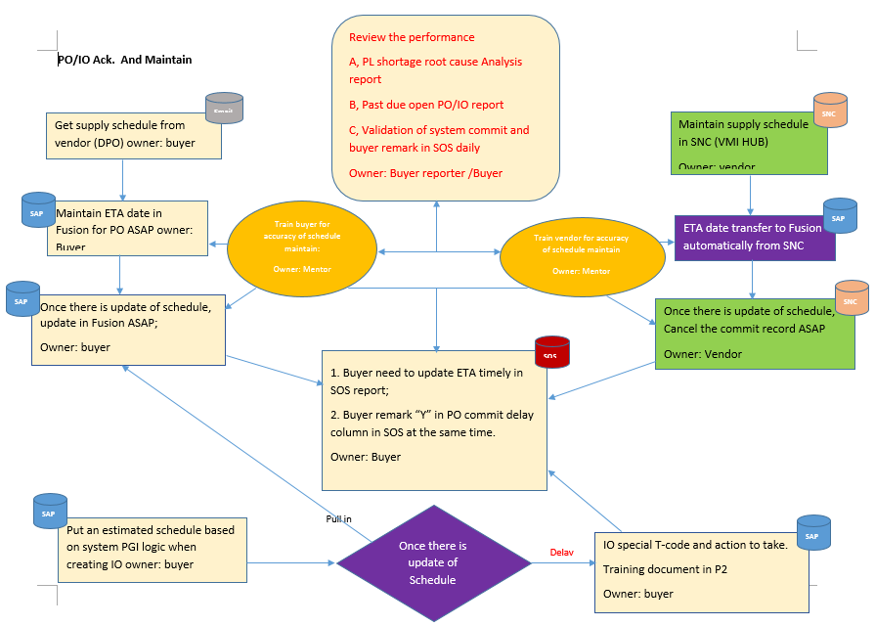
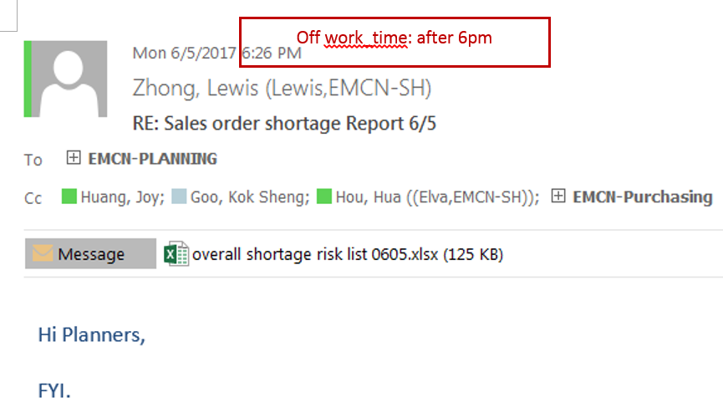
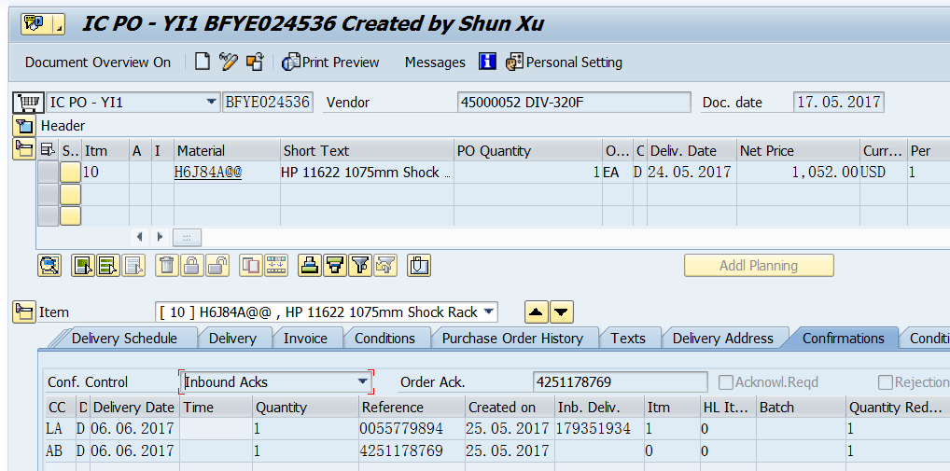
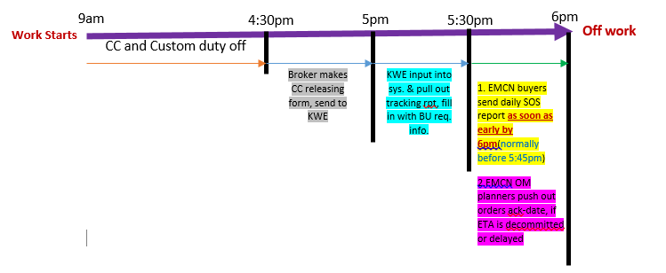
Prep Review
GEMBA
Kick Off
Daily Wrap
Final Report Out
Team 7: Accuracy of customers' orders' delivery ack-date improvement
IO ack. & PO ETA is wrong in sys.
Late daily notice of late supply ETA upon daily CC info. from Custom Ops’ agent, wrong tracking report data of agent
Supply schedule de-commits, i.e. Intel CPU HUB
PO ETA maintenance training doc. in SAP, SNC sys. & daily SOS report;
Training doc. Of IO ETA maintenance in sys.
Set deadline per WD daily SOS Rpt is ready to OM
Intel CPU Fcst upside/allocation process
On track, decrease related cases of order reversal
1. IO ack. & PO ETA is wrong in sys.
2.Late daily notice of late supply ETA upon daily CC info. from Custom Ops’ agent, wrong tracking report data of agent, late daily notice of supply de-commit cases.
1. PO ETA maintenance training doc. in SAP, SNC sys. & daily SOS rpt:
2.Biz alignment with HPE Custom Ops of daily CC tracking report publishing_deadline to EMCN buyers, daily SOS report publishing_deadline to EMCN OM planners:
4251201690
4251201919

Slide 9
Appendix:
Purchasing’s task:
SOS training document
EOL parts review monthly
CPU upside process with vendor

Slide 10
Kaizen Detail
Excess Depletion Process
Iris Ge & Binimo Liu

Slide 11
What is the Change?
-Process
-Operation

Slide 12
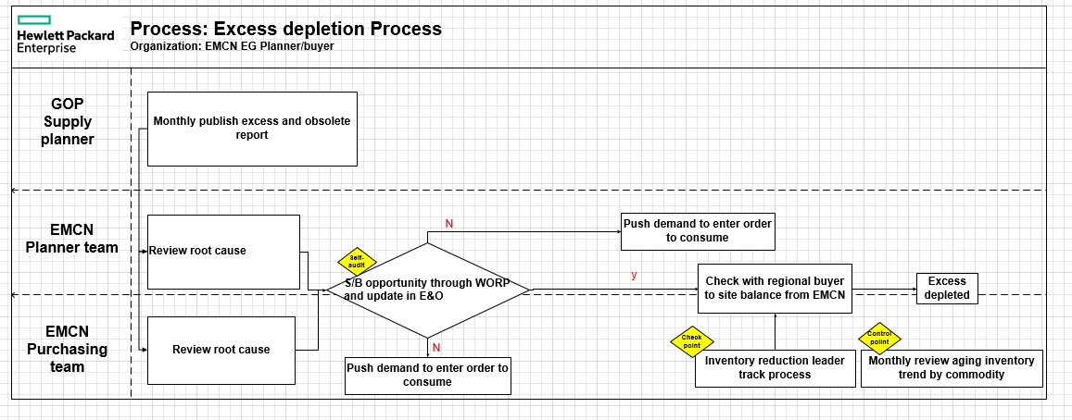
Process
WH

Slide 13
Operation
WH
Material | action item | reason | WORP tool status | action taken
872352-B21@@ | accrual | fcst downside | ap has demand/ ww excess,no S/B opportunity/ High consumption,keep/etc.. | checked with ams, will take 10pcs/ checked with emea,no need as will rework from another part/..etc
根据7月份的E&O report，80% accrual$料号大部分buyer 少于15个
若数量多于15个就查询TOP 15并且take相应action

Slide 14
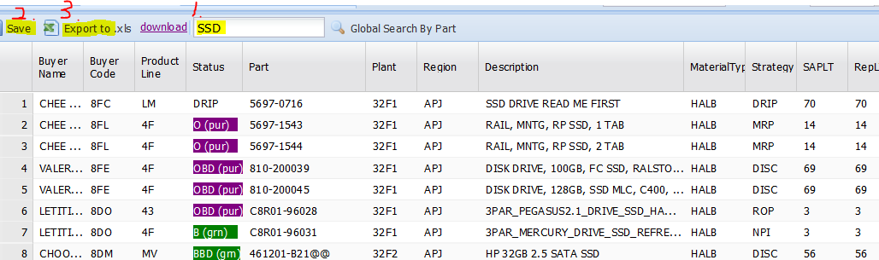
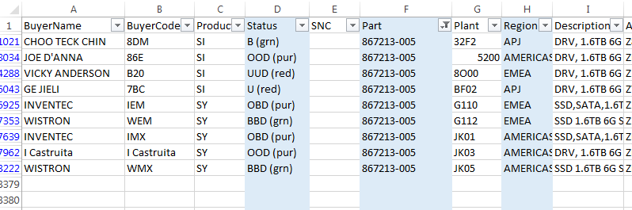
WORP tool
WH
在WOPR不做任何选择，就可以download下所有site所有料号的status, 只是文件比较大，
需要花8分钟download下来，文件有107M, 45万条记录.
WOPR Global search, 可以输入一个P/N或者一个关键词(譬如HDD/SDD),
那就会跑出所有相关联的site的内容,SSD 测试，1分钟左右（way: input 关键字→Save→Export to）

Slide 15
Kaizen Detail
Shortage material receiving process improvement
Bella Yao

Slide 16
What is the Change?
-Process
-System
-Operation

Slide 17
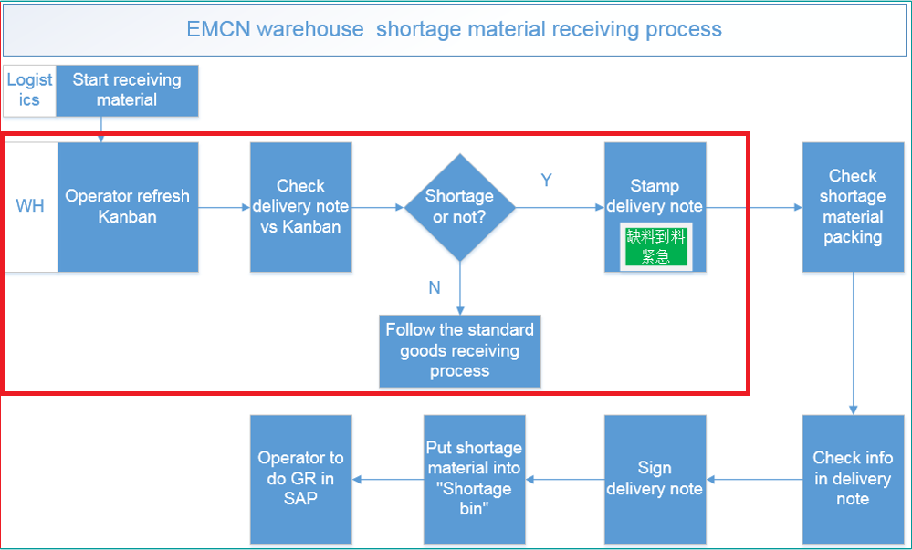
New receiving process for shortage material
WH

Slide 18
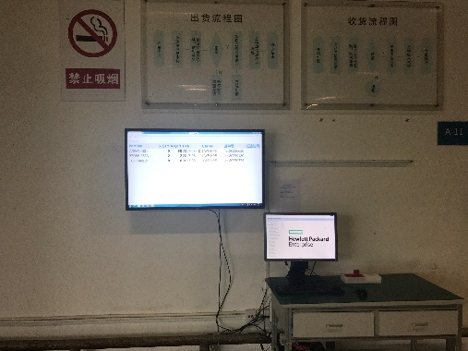
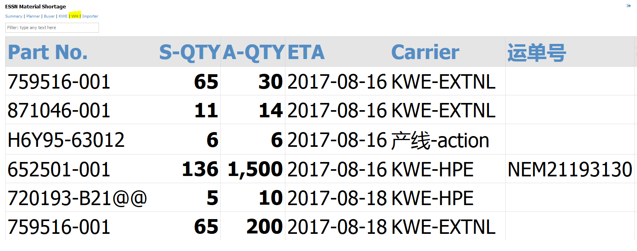
Kanban
Shortage material visible to W/H operator

Slide 19
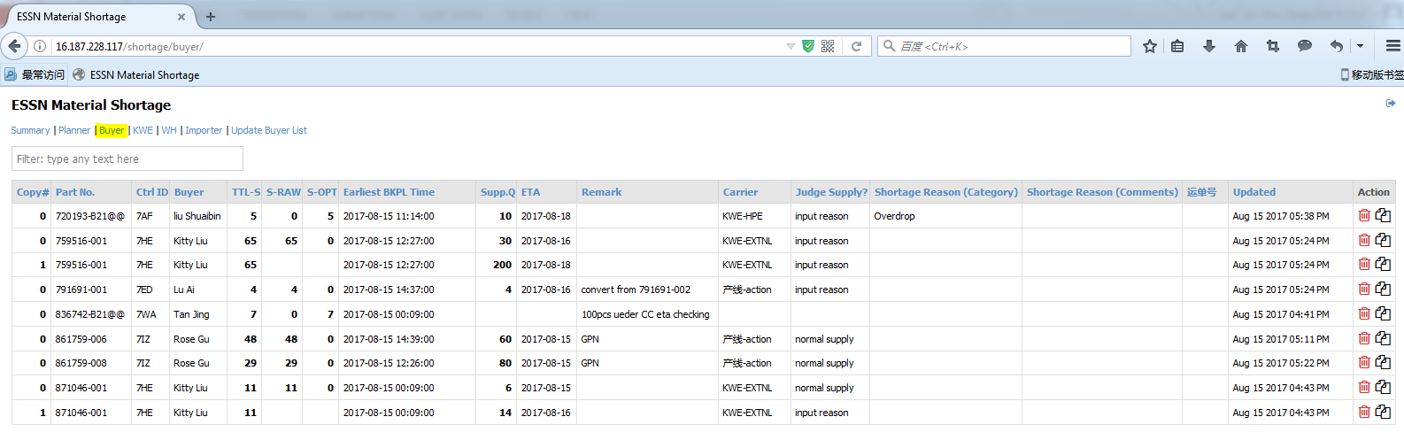
Operation
Update supply information for shortage material (at least twice a day)

Slide 20
Operation
Linkage: http://16.187.228.117/shortage/buyer/ -- Select “Buyer” 界面
1. 安装Google Chrome / Firefox 浏览器
2. 每天至少两次更新Kanban (上午11:30 前; 下午 17:30前)
3. 必填信息：
Supp.Q
ETA
Carrier
Shortage reason
HAWB (Carrier:HPE-KWE)

Slide 21
Question
1. Reminder 功能
2. ETA Time

Slide 22
New SOS Report
http://16.187.225.122/emcn-purchasing
Cindi

Slide 23
Appendix:

Slide 24
Thank you！

